Slide 1
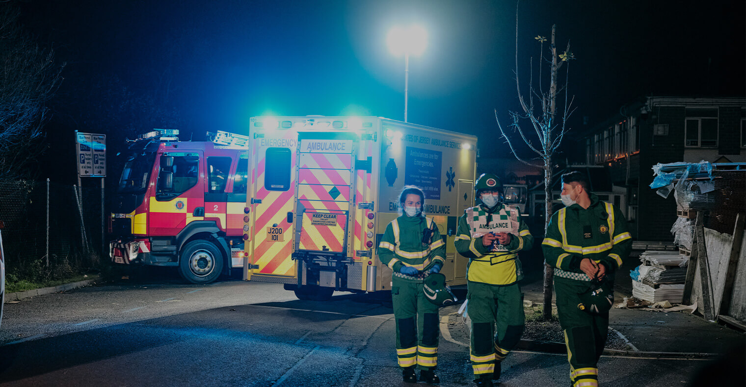
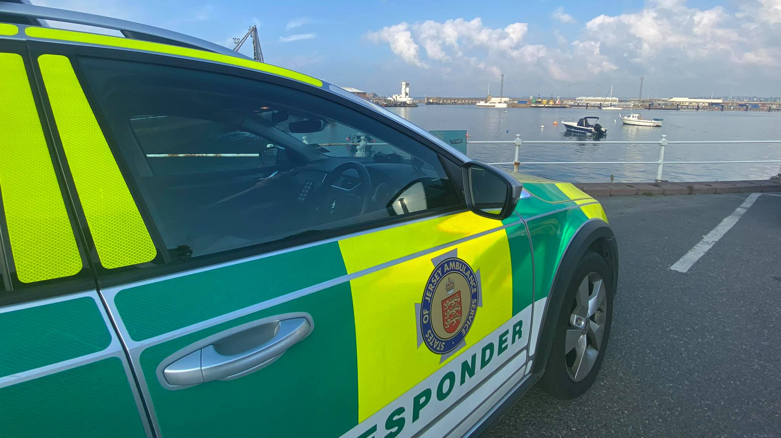
Ambulance Recruitment
Candidate Briefing Pack:
Head of Clinical Quality and Effectiveness

Slide 2
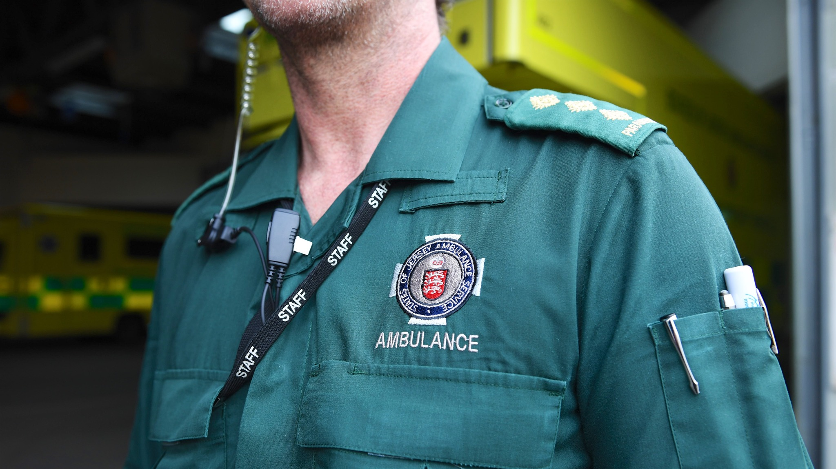
Contents
Introductory message 03
About Jersey 04
About Jersey Ambulance Service 06
Overview of positions 09
Structure chart 11
Application process 12

Slide 3
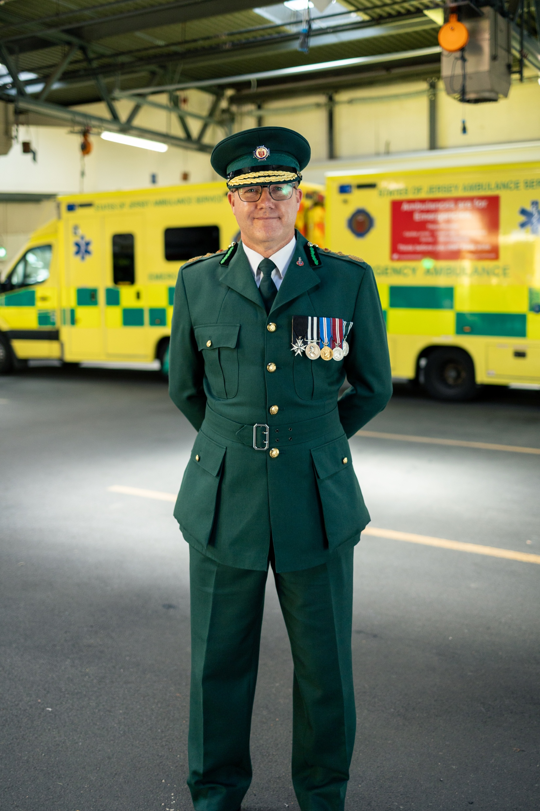
Dear Applicant
Thank you for expressing an interest in the States of Jersey Ambulance Service (SJAS).
This pack is intended to provide you with information to use in submitting your application.
Our service is growing, and we are recruiting a range of different positions to provide emergency prehospital care to the public of Jersey.
I look forward to receiving your application.
Peter Gavey
Chief Ambulance Officer

Slide 4
About Jersey
Jersey is the largest of the Channel Islands, with an area of 45 square miles. The island combines a lively and cosmopolitan main town, which is home to our global finance sector, with sweeping, unspoilt beaches, fishing ports and rolling countryside. Just 14 miles off the north-west coast of France and 85 miles south of the English coast and it is very well served by air to a range of UK and international cities.
Jersey is a Crown Dependency. While it’s in the British Isles, it’s not part of the UK. Yet, it feels like a home from home, thanks to its sterling currency and familiar high street shops, restaurants and supermarkets.

Slide 5
Jersey has a proud and complex history – from how it got its name, the plundering of Vikings in the ninth century, to a valuable island outpost, fought for over centuries by the English and French, whose traces remain in the Jèrriais language, in the names of streets and long-established families, and in the heritage of the legislature.
Its occupation by German forces during World War II left a deep imprint on the island's character, as well as visible reminders – from the gun emplacements dotted around the coast to the underground hospital, which is now a war museum. These are now an important part of our cultural heritage, as are the historic castles, forts and Martello Towers that defended the island.
Relocating here means you’ll enjoy the best that outdoor island life has to offer. From beach walks to coastal drives, from boat trips to water sports, and from heritage sites to rolling countryside – you’ll have your pick of what to see and do.

Slide 6
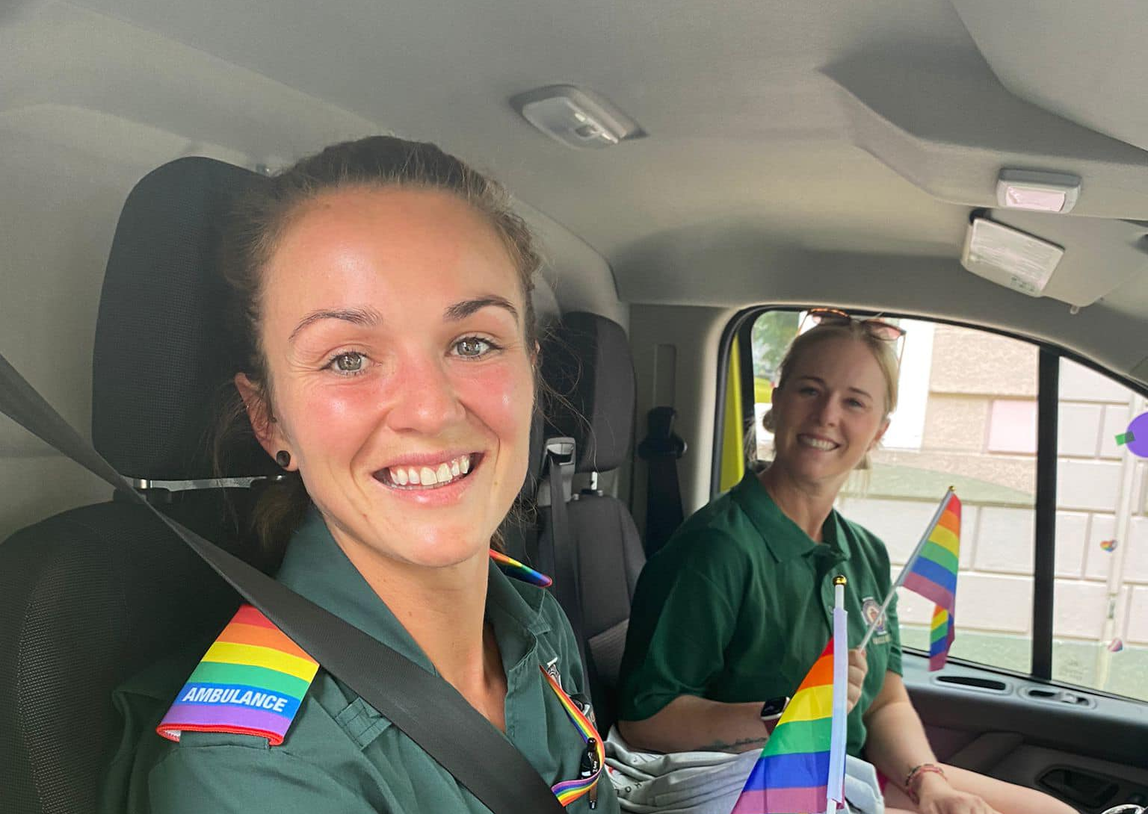
About the States of Jersey Ambulance Service
When incidents happen we are amongst the first responders when the community needs help. Our team provides an emergency service, 24 hours a day seven days a week to help Islanders in need.
Our Ambulance Service takes pride in delivering the extraordinary every day to keep people safe and help those who need it most. From sporting to road accidents, home incidents to multi service responses our team cover all bases.
We have to be prepared for all eventualities, providing the island’s answer for both minor and major incidents.
As well as emergency care, our work covers patient transport, safety advice, outreach with local schools and attending community events.

Slide 7
Our Core Principles
Our guiding principles and values apply across our service to ensure a person-centred approach is maintained in all that we achieve. A person-centred approach means that people are treated with dignity and respect and can make informed decisions, where possible, about the care we provide
Mission
To deliver exceptional patient centred services through a skilled and committed workforce.
Vision
Delivering the right patient care, in the right place, at the right time through modern, effective and committed workforce, that is collaborative and responsive to the needs of Jersey’s communities.
Ambulance Service Guiding Principles
As part of the wider Justice and Home Affairs Department and Government, we are guided in everything we do, though our public service values. Whilst supporting the Government of Jersey values, we recognise as an Ambulance Service we need to be community focused and safe in everything we do.

Slide 8
Our Values
We are respectful We care about people as individuals and show respect for their rights, views and feelings.
We are better together We share knowledge and expertise, valuing the benefits of working together.
We are always improving We are continuously developing ourselves and our services to be the best they can be for Jersey.
We are customer focused We are passionate about making Jersey a better place to live and work for everyone.
We deliver We are proud of Jersey as a place and are passionate about shaping and delivering great public service.

Slide 9
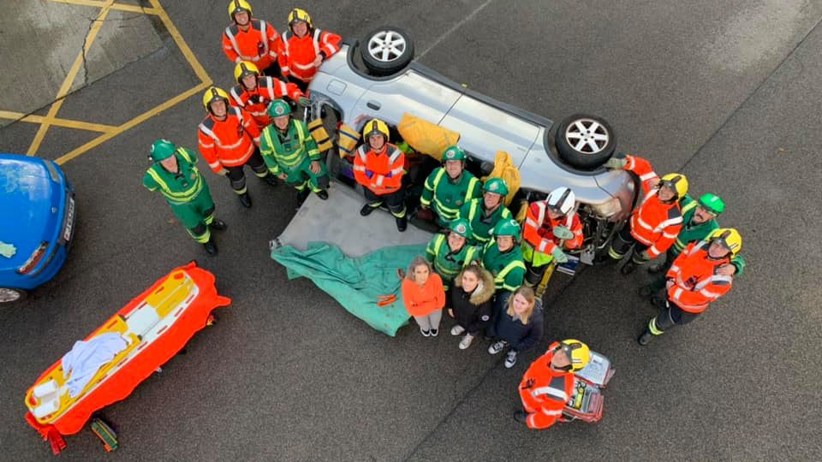
Our Opportunity – Head of Clinical Quality and Effectiveness
We are seeking dedicated and passionate medical practitioners to make an impact and ensure the well-being of our expanding population.
Our team of Clinicians enjoy the benefits of one hospital in Jersey that covers most patient health needs.
One emergency services department – our ambulance team enjoy the close and collaborative relationship with the police, health and fire service.
Due to the small size of Jersey the ambulance team are able to maximise patient care quickly and efficiently.
Jersey enjoys a close relationship with the UK including the same vehicles, equipment, JRCALC+ and free access to PARAPASS CPD.
We support your training requirements and encourage our team members to progress with their career ambitions.
Be part of a high performing ambulance service – we consistently achieve a benchmark of 90th centile in the ambulance response programme (ARP).

Slide 10
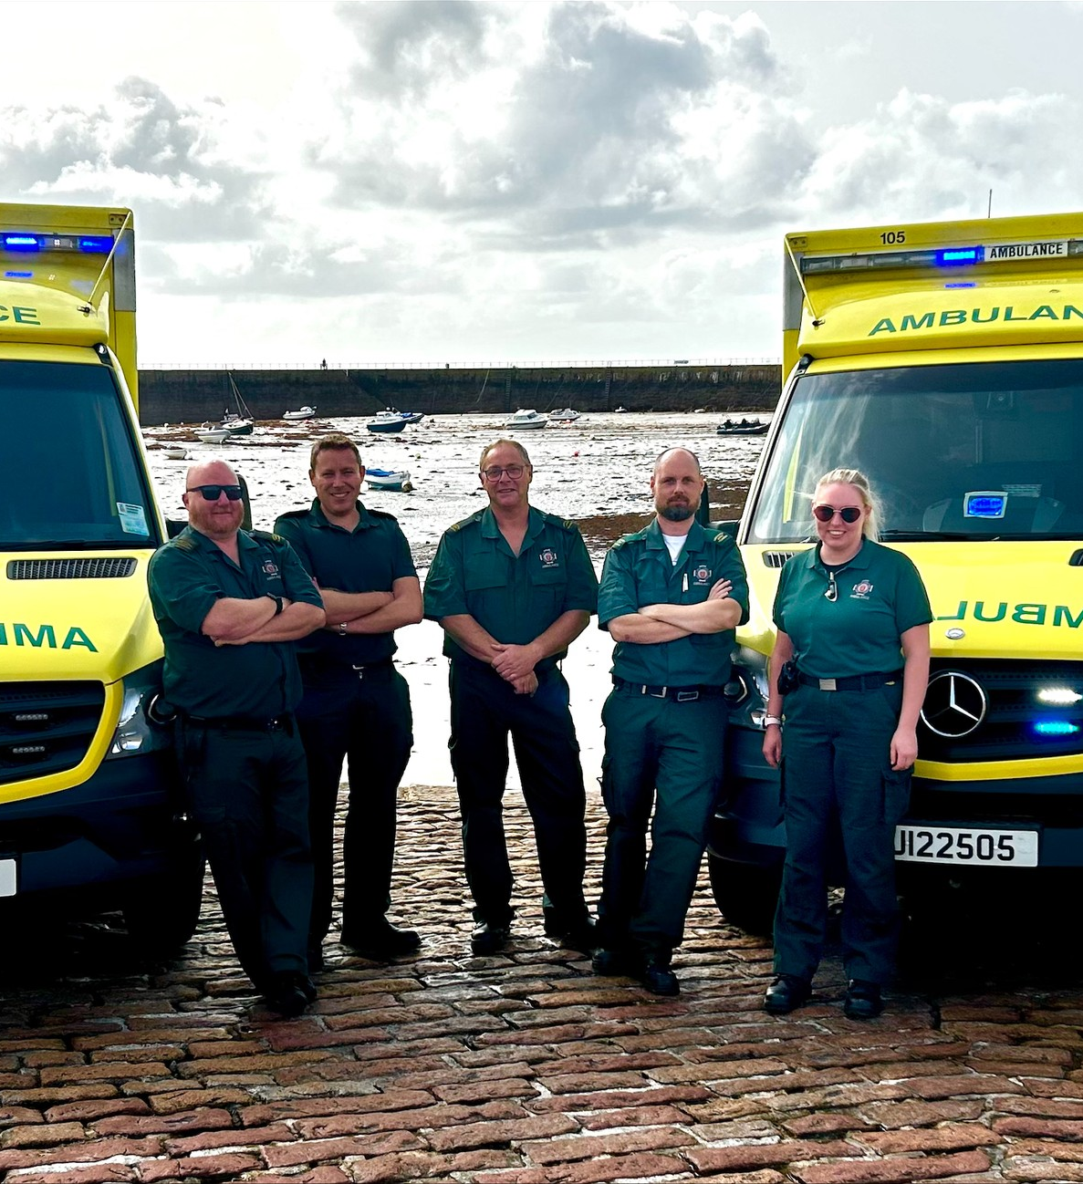
Key responsibilities
Responsible for leading the delivery of a safe and effective patient centric model of care for the ambulance service.
Developing, implementing, and monitoring robust and comprehensive systems and processes around clinical governance, learned events, patient safety, quality of care and alternates to care.
To lead and manage a team of specialist practitioners, through the implementation of new initiatives and referral pathways to effectively manage relevant 999 calls and demand.
Provide a strong, visible and engaging clinical leadership presence across the Service.

Slide 11
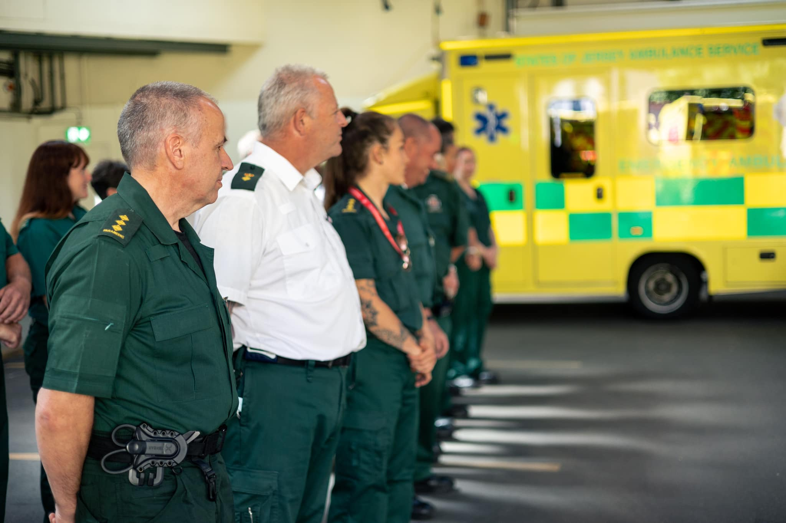
To be successful you will:
Hold the Bsc (Hons) in Paramedic Practice or equivalent in a subject relevant to Paramedic practice.
Be MSc or HE level 7 qualified or have an equivalent qualification in a subject relevant to advanced clinical practice.
Hold a recognised qualification in management at NQF level 5 or equivalent.
Be an experienced manager with a proven track record of working within a health-based organisation.
Applications will be considered from Allied Health Professionals who can demonstrate experience working at an advanced practice level.
The pay range (£58,926 - £75,089) reflects an opportunity for candidates who do not meet all the essential criteria but may be suitable for a developmental programme with the lower pay scale being used in this circumstance.

Slide 12
Structure chart – Ambulance Leadership Team
Chief Ambulance Officer
Associate Chief Ambulance Officer
Clinical Governance & Risk
Medical Director
Associate Chief Ambulance Officer
Operations & Support
Head of Clinical Quality & Effectiveness
Head of Regulation & Compliance
Analyst
Head of Operations
Head of Operational Support
Head of Emergency Preparedness, Resilience & Response

Slide 13
Application process
Application closing date:
21 April 2024
Job number:
SOJ16139
Contract type:
Permanent and full time
How to apply:
Applications can be made here or via the below link:
https://www.gov.je/Working/JobCareerAdvice/Pages/details.aspx?nPostingId=136562&nPostingTargetId=235358&id=QE8FK026203F3VBQB7V687VU8&LG=UK&languageSelect=UK&mask=saifext
For an informal chat about this opportunity, please contact James Inglis, Associate Chief Ambulance Officer on 01534 44743 or J.Inglis@health. gov.je

